Slide 1
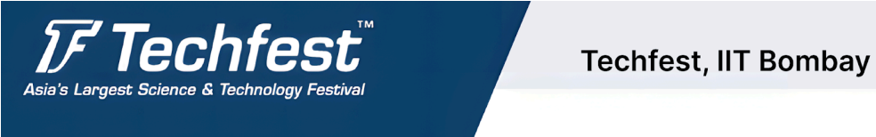

Veda-VisionGPT –An AI-Powered Multilingual Document Processing and Interaction Platform
Team Name :- AI SENTINELS
Team ID :- puls-230383
Presented by : 1. Kunal Sapkal
2. Sanika Kadam
3.Rutuja Mulik
4.Vinayak Gharge
5.Ashay Vairat

Slide 2
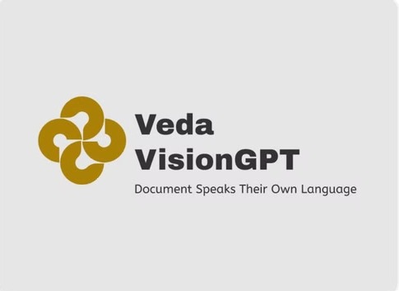
INTRODUCTION TO VEDAVISION-GPT
Comprehensive Multilingual Document Management: VEDA-VISION GPT integrates OCR, translation, and AI-powered question-answering to process documents across Indian languages, enabling natural language queries and enhanced information extraction.
Transforming Cross-Lingual Access: Designed for government, legal, and academic sectors, the platform revolutionizes information access and engagement, bridging language gaps for diverse linguistic communities. with our logo.
Centralized platform: for document storage and retrieval, Enhanced search functionality with language-agnostic capabilities, Streamlined workflow for document organization and categorization, Improves efficiency in managing large volumes of multilingual documents

Slide 3
Problem statement
Challenges in Document Processing : Document processing today faces significant challenges, including inefficiencies caused by time redundancies, human errors during manual handling, and limited support for diverse document formats, etc.
Case Study – Societal Impact in Governance and Academia : Government officials in India often encounter non-machine-readable regional language documents, especially in fields such as law, and education. For example, a rural district office may struggle to process a legal PIL written in Tamil or a government directive in Bangla. These barriers reduce operational efficiency, and widen the communication gap between regional and national authorities. Similarly, in academia, translating and analyzing regional research papers often becomes a bottleneck due to the lack of contextual AI systems supporting Indian languages.
Need for an Intelligent System : Fragmented approaches to language processing significantly reduce productivity and lead to inconsistencies across various sectors of society. This highlights an urgent demand for a unified AI-powered solution capable of handling extraction, translation, and question-answering across multiple Indian languages. A system addressing these gaps would not only ensure accurate and context-rich outputs but also empower industries to bridge linguistic divides and promote transparency.

Slide 4
Proposed System - Veda-Vision GPT
Unified Solution
An AI-powered multilingual platform for processing non-machine-readable documents, Veda-Vision GPT integrates OCR, neural machine translation, and an intelligent Q&A system to efficiently extract, translate, and analyze text across 15+ Indian languages, advancing NLP capabilities.
Text Extraction Module
Before: Limited extraction capabilities for Indian languages, low accuracy for complex scripts
Our Solution: The system uses advanced OCR technology, including Tesseract and Easy OCR, optimized for Indic scripts, with custom image preprocessing to boost text recognition accuracy for complex documents.
Text Translation Module
Before: Generic translation tools with limited capacity of words for translation.
Our Solution: The system utilizes NMT models for over 15 Indian languages and provides increased capacity to translate and download text.
Question Answering Module
Before: Basic keyword search, limited understanding of natural language queries
Our Solution: The AI-powered system leverages GPT and BERT models for accurate, context-aware responses and supports multilingual querying in various Indian languages.

Slide 5
Objectives
Develop an Advanced Unified Solution: Design a unified platform ; Veda-Vision GPT that integrates OCR, neural machine translation, and an intelligent Q&A system to efficiently extract, translate, and analyze text.
All Document Format Support: Implement functionality to successfully extract text from all types of document formats including PDFs, Docs, JPG, etc.
Integrate an AI-Driven Question-Answering Capability: Develop a system that enables users to interact with document content through queries in the own language of the document , generating responses by combining information from the document with insights from an LLM.
Handle Non-Machine Readable Documents : The platform supports machine readable as well as non-machine readable documents of all formats.
Enhance Information Accessibility Across 15+ Languages: The platform provides a support of 15+ Indian Native Languages for Extraction, Translation and Q&A.

Slide 6
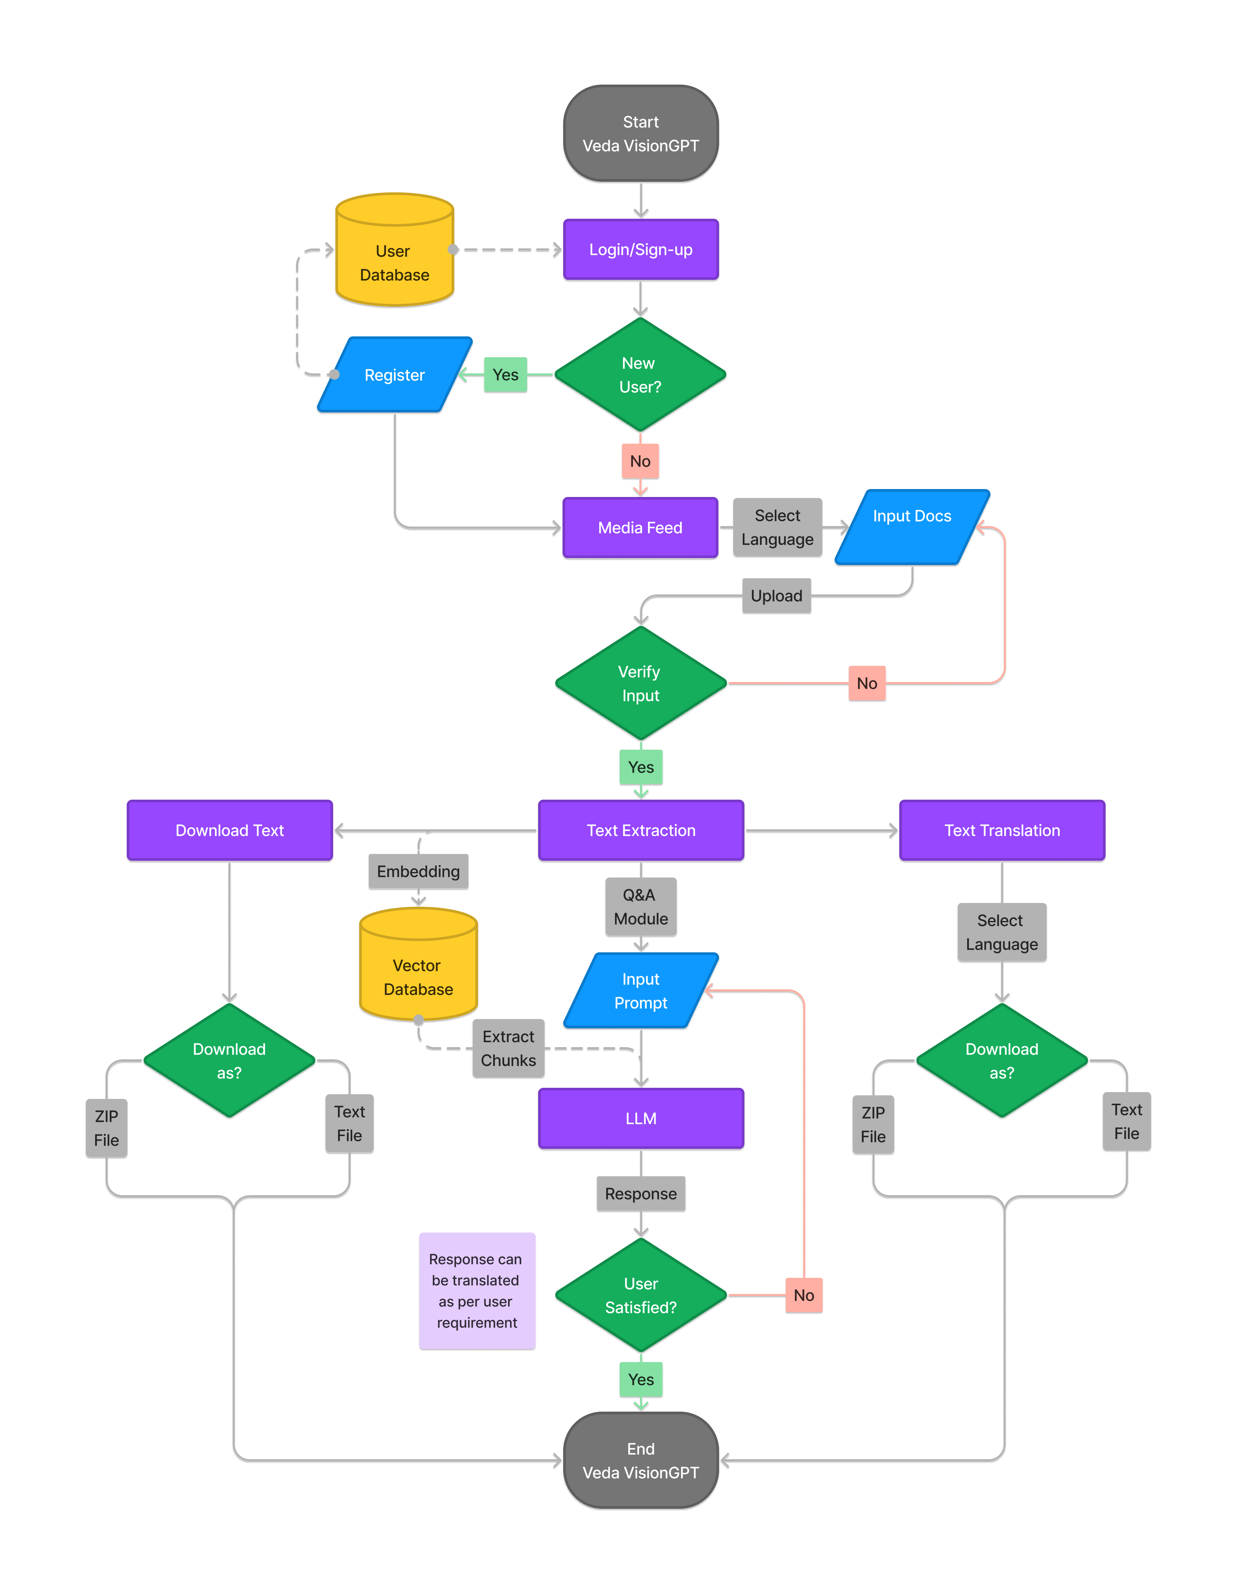
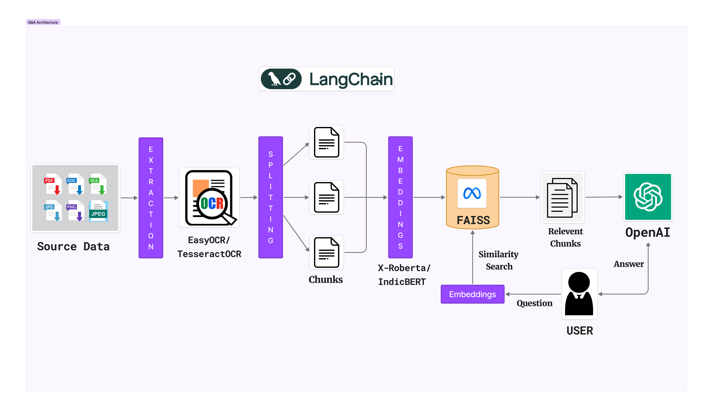
System Architecture
Retrieval Augmented Generation :
VedaVisionGPT
Workflow Diagram : VedaVisionGPT

Slide 7
Technology Stack
Small Scale Model:
Cloud Provider: GCP
Frontend Framework: Streamlit (open-source)
Frontend Hosting: Streamlit Cloud
OCR Tool: Tesseract OCR , EasyOCR(open-source)
Translation Tool: Deep Translator, Microsoft Translator(open-source).
AI Model Hosting: Hugging Face Inference API (free tier)
Container Deployment: Google Cloud Run.
Database: FAISS, Firebase(Authentication).
Large Scale Model:
Cloud Providers: GCP
Framework: Streamlit
Frontend Hosting: Deploy Streamlit on Kubernetes
OCR Tool: Easy OCR or Google Vision API.
Translation Tool: Google Translate API
AI Model Hosting: Deploy models on GPU clusters Autoscaling: Kubernetes
GPU Resources: Dedicated GPU instances.
Container Deployment: Deploy Docker containers using Kubernetes
Database: Use managed databases( Google Cloud SQL) enable autoscaling

Slide 8
Uniqueness Of Our Solutions
Comprehensive Multilingual Support:Unlike other rivals who focus on worldwide languages, Veda-VisionGPT covers 15+ Indian languages, filling a significant void in local language processing and translation.
Integrated Platform : The system effortlessly integrates OCR, translation, and AI-powered question-answering into a single platform, resulting in a streamlined solution. Many existing systems provide these functionalities in isolation, resulting in fragmented processes.
Context-Aware Responses:Veda-VisionGPT uses Retrieval Augmented Generation (RAG) and Natural Language Processing (NLP) and Large Language Models (LLMs) to provide contextually appropriate responses, improving user engagement with multilingual documents, which is uncommon in other systems.
Tailored for Indian Markets : Unlike worldwide competitors, it is specifically developed for Indian industries such as government, legal, and education.
Non-Machine Readability : The platform supports all types of document formats especially non-machine readable documents, which is uncommon for other existing extraction platforms.

Slide 9

Working Prototype (MVP)
CTRL + Click the screen to get the video link👆

Slide 10
market potential
Untapped Market Potential: Integration with e-commerce platforms and business services for automated multilingual document processing and customer support.
Healthcare Innovation: Streamlining patient records and medical documentation across regional languages to improve healthcare delivery and accessibility.
Digital Governance: Transforming government service delivery through efficient processing of multilingual administrative documents and citizen requests.
Government and Legal Sectors: High demand for multilingual document processing to streamline administrative tasks, digitize legal records, and enhance public accessibility across India's linguistically diverse population.
Education and Corporate Environments: Significant opportunity in providing localized educational resources and facilitating multilingual business communications, improving inclusivity and collaboration.

Slide 11
Market analysis
Metric | Focus | Estimated Value (INR) | Assumptions
Total Addressable Market (TAM) | Focus on the global OCR, translation, and AI-powered question-answering markets. OCR market (2023): ~$12B globally. Translation and language services market (2023): ~$60B globally. Considering multilingual AI, add 10%. | ₹5,94,000 Cr (Global) | Total global market for AI-driven document processing. OCR and translation services combined.
Serviceable Available Market (SAM) | Focus on Indian market, particularly multilingual sectors (legal, government, education). ~3% of TAM based on India’s contribution to AI-driven solutions. India’s AI market projected to reach $7B by 2030. | ₹17,820 Cr (India) | 3% of global market is India’s share. High need for multilingual solutions in India’s sectors.
Serviceable Obtainable Market (SOM) | Initial focus on legal, academic, and government sectors in India. Capture 5% of SAM in early stages due to competition and market penetration efforts. | ₹891 Cr (Early Stage) | Assumes initial capture of 5% of the serviceable market. Gradual scale over 3-5 years.

Slide 12
Future Scope
Broaden Language Capabilities:
Expand the system’s capabilities to include a wider range of Indian languages.
Add functionality for processing and translating Sanskrit to accommodate classical and historical texts.
Enhance System Efficiency:
Focus on optimizing the system to improve processing speed and reduce delays.
Increase operational efficiency thereby reducing document processing time.
CPU Optimization:
Examine the feasibility of transitioning from GPU to CPU for running the system, aiming to lower costs and enhance accessibility.

Slide 13
THANK YOU
ANY QUESTION

